Slide 1
WEB Scrapping project
Camille Libert-Coubard
April 2020

Slide 2
Table of contents
Objectives
Methodology and workflow
Results
Conclusion

Slide 3

Objectives of the project
Collect information about products on Carrefour.fr
Understand products, and more specifically:
Project aimed at:
Carrefour competitors
Industrial brands
Category managers
Promotions:
The number of promotions
The categories and subcatgories being the most promoted
The type of promotion
The brands promoting the most on the website
Products, in their category:
Most represented subcategories
Top brands
Global prices and products sold on the website

Slide 4
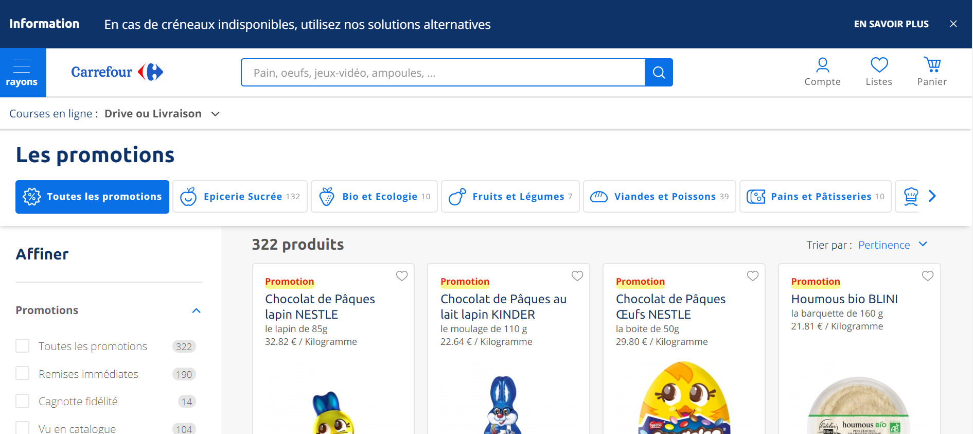
Carrefour webpage
https://www.carrefour.fr/promotions

Slide 5
methodology
Number of pages
Html & CSS: computes number of products in total, and then number of pages to scrap
Scrapping method
API: contains more information (e.g. EAN, price discount, dates for promotions)

Slide 6
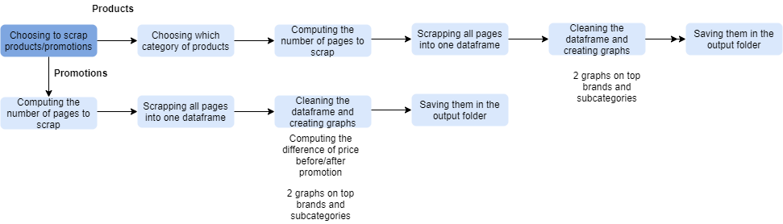
workflow

Slide 7
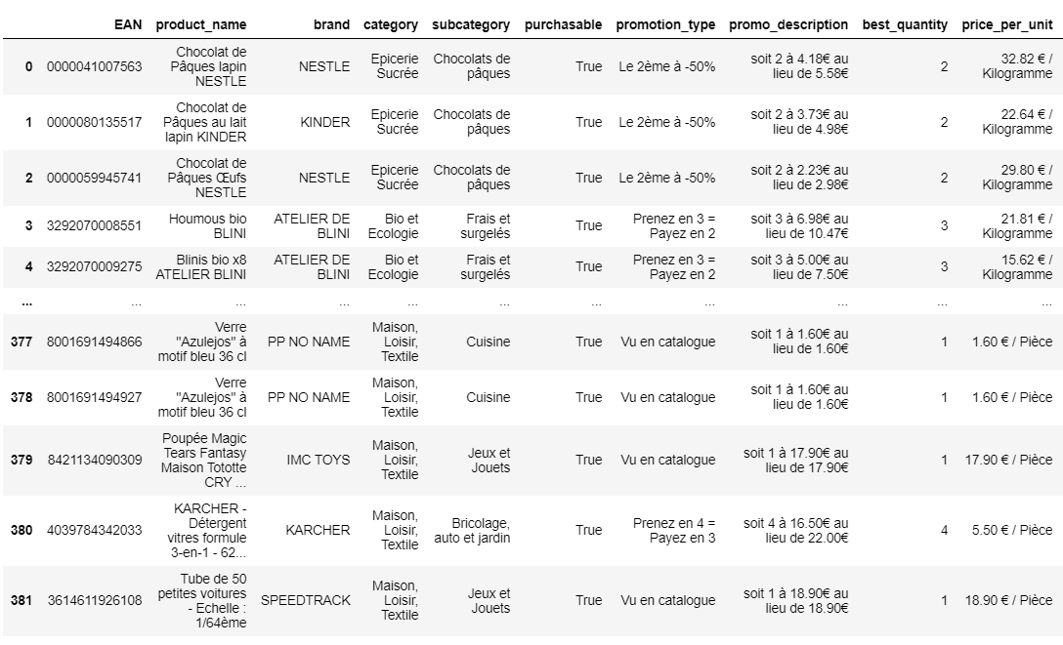
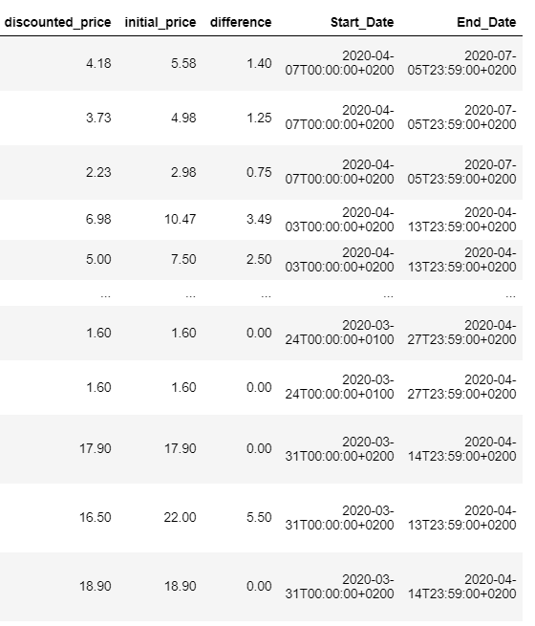
Results For PROMOTIONS (1/3)

Slide 8
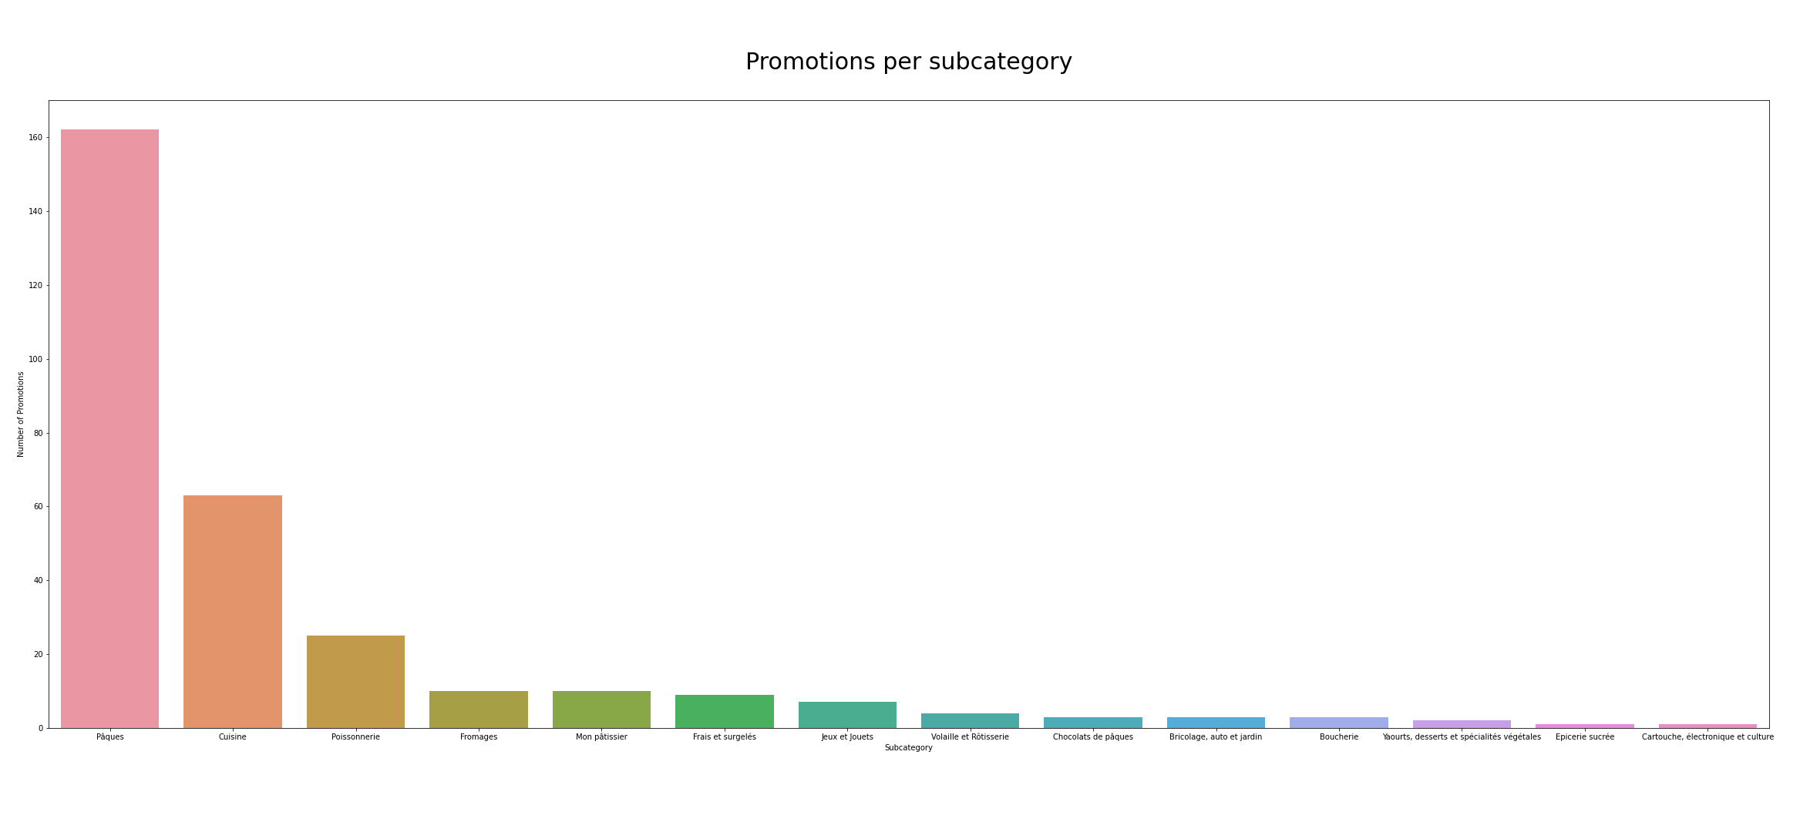
Results for promotions (2/3)

Slide 9
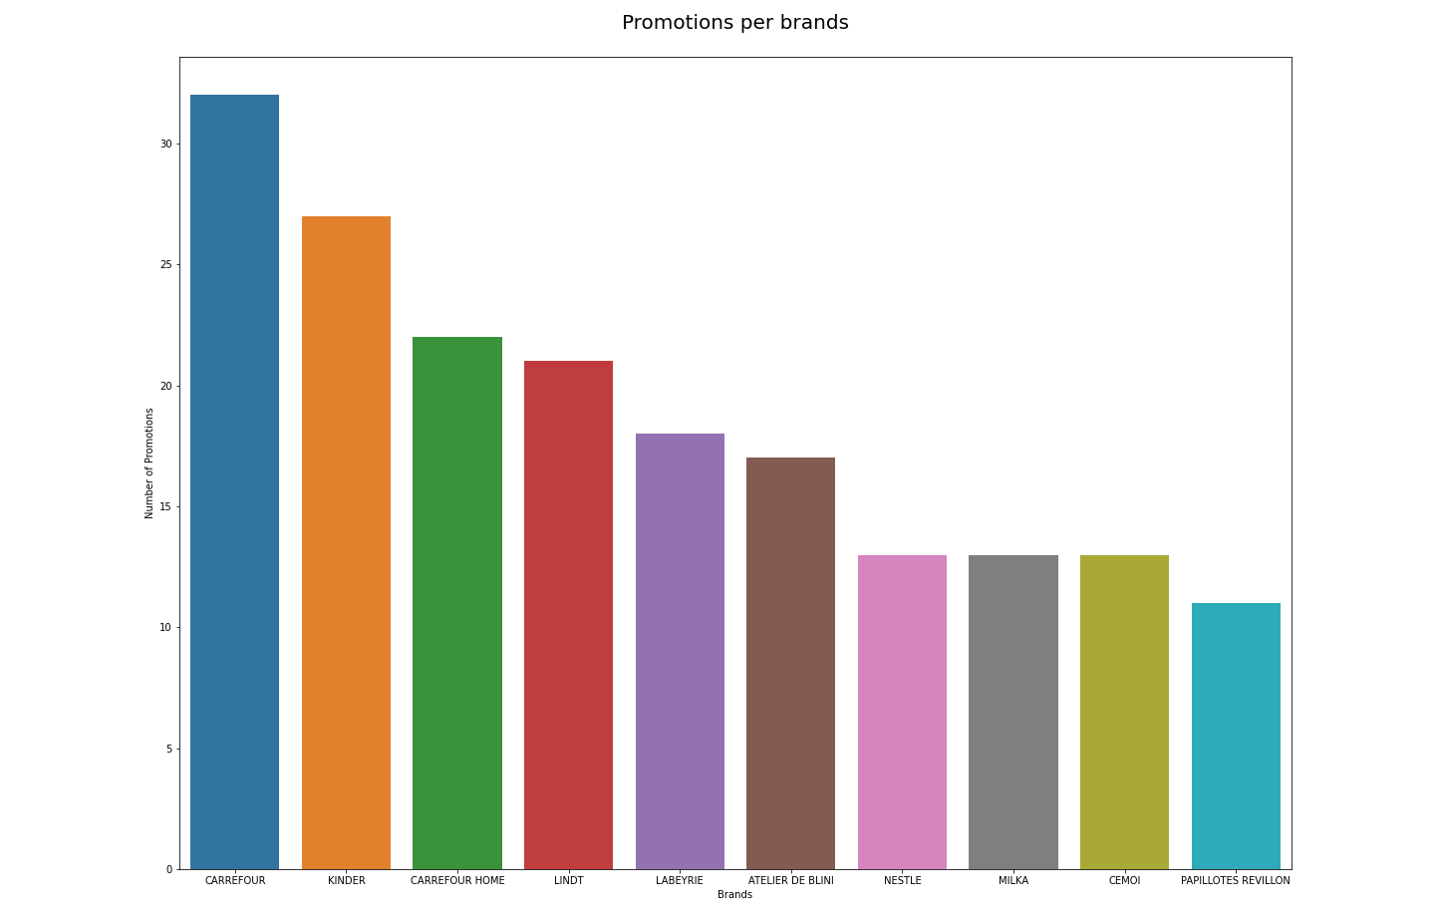
Results for promotions (3/3)

Slide 10
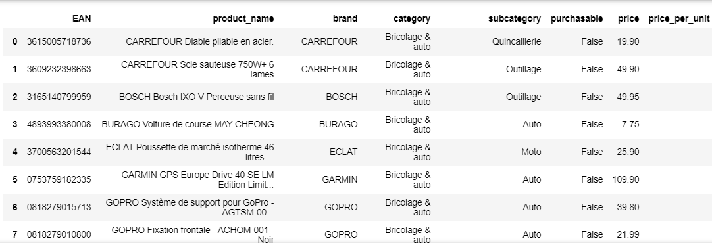
results for products (1/3) e.g. bricolage-auto

Slide 11
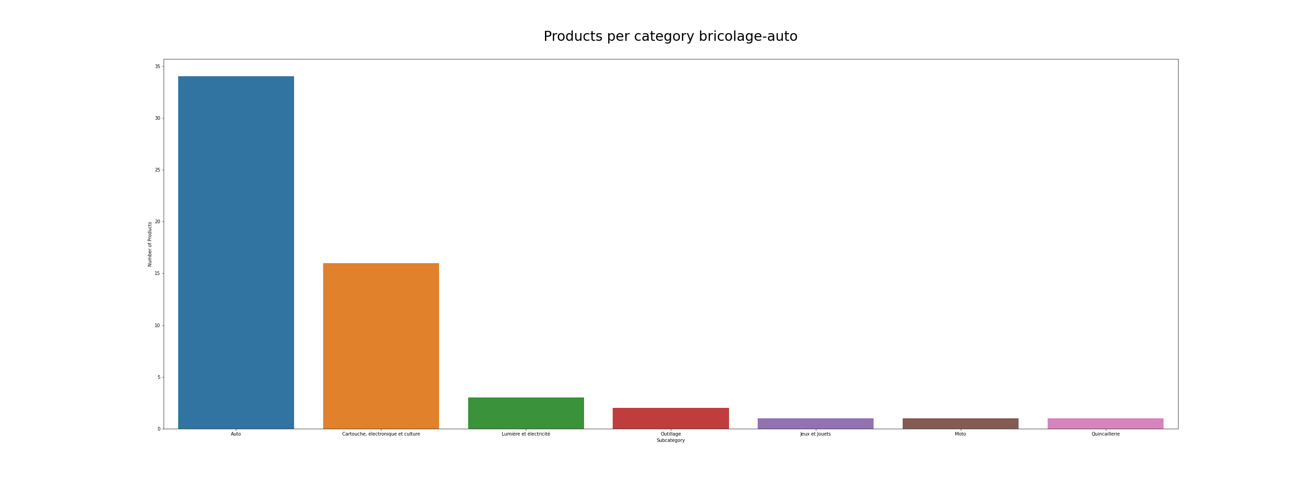
results for products (2/3)

Slide 12
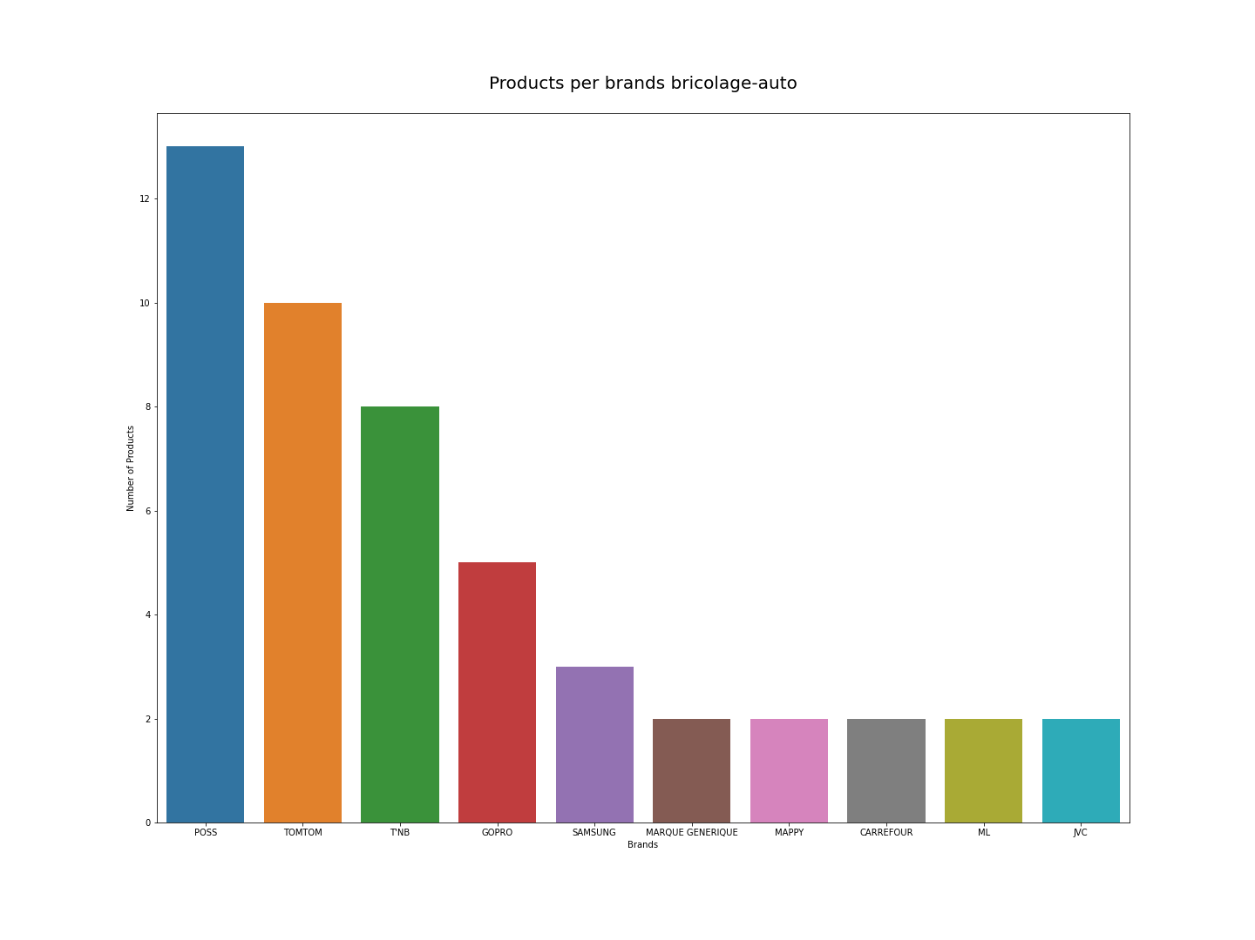
results for products (3/3)

Slide 13
Conclusion
Obstacles
Choosing the right website and scrapping method
Learnings
How a website is structured
How to clean a json output
Better understand functions and data pipelines
Improvements
Scrapping competitors websites

